Slide 1
Group F: Milestone 3 Presentation

Slide 2
Background & Previous Work

Slide 3


Original Project Goals
We predict that we can identify a correlation between overall sentiment in tweets and case count trends at different US cities by comparing sentiment in COVID-19 related tweets in the US to COVID-19 case data
We plan to build an application that will scrape tweets related to Covid-19 from twitter, and then predict and display possible new Covid-19 hotspots
+
Notes:
Relevance to current issues + objective of project
Uncertain about application ---> will help predict hotspots

Slide 4
Previous Work
Data Setup & Training Results
Sentiment doesn’t seem to be a good indicator of the number of cases
Favorites play a larger role than sentiment
Move focus away from sentiments
Formulate more metrics based on tweet and COVID case data
Focus on leveraging other NLP data from tweets
Application
Streamline data pipeline to gather and hydrate the previous week’s tweets
Sliding window approach
Extract information from hydrated tweets (e.g. sentiment analysis)
Have our model output predicted COVID cases

Slide 5
Updated Project Goals
We predict that we can identify a correlation between relevant tweet information and case count trends at different US states by using different tweet properties in COVID-19 related tweets in the US to COVID-19 case data
We plan to build an application that will use COVID-19 tweets from the previous week to locate and display possible new COVID-19 hotspots
+
Notes:
Relevance to current issues + objective of project
Uncertain about application ---> will help predict hotspots

Slide 6
Updated Dataset

Slide 7
Updated Dataset: NLP Data and Twitter Data
Sentiment alone wasn’t effective or useful
Incorporated Google NLP API results
Sentiment Analysis: Sentiment, Magnitude
Entity Analysis - Entity Type
Person, location, organization, event, artwork, consumer product, phone number, address, date, number, and price
Incorporated more tweet information
Favorite count, follower count, friend count, number of tweets, hashtag count, retweet count, status count, and whether the users are verified
Compiled COVID Case data using a sliding-window based approach
Number of new cases and deaths

Slide 8
Training Results

Slide 9
Model: Regression
Mean Absolute Error (MAE)
The average absolute difference between the labels and predicted values. Values range from 0 to infinity, where a lower values indicate a higher quality model.
Root-Mean-Square Error (RMSE)
Measure of difference between the values predicted by the model and the values observed. Ranges from 0 to infinity, where a lower value indicates a higher quality model
RMSLE → RMSE in logarithmic scale
Coefficient of Determination (R^2) :
The square of the Pearson correlation coefficient between labels and predicted values. Ranges from 0 to 1, where a higher value indicates a higher quality model
Feature Importance
Relative importance of each feature, determined by how much the prediction varies when the value changes. Higher variance in the prediction indicates a greater importance
Notes:
Todo: fix this

Slide 10
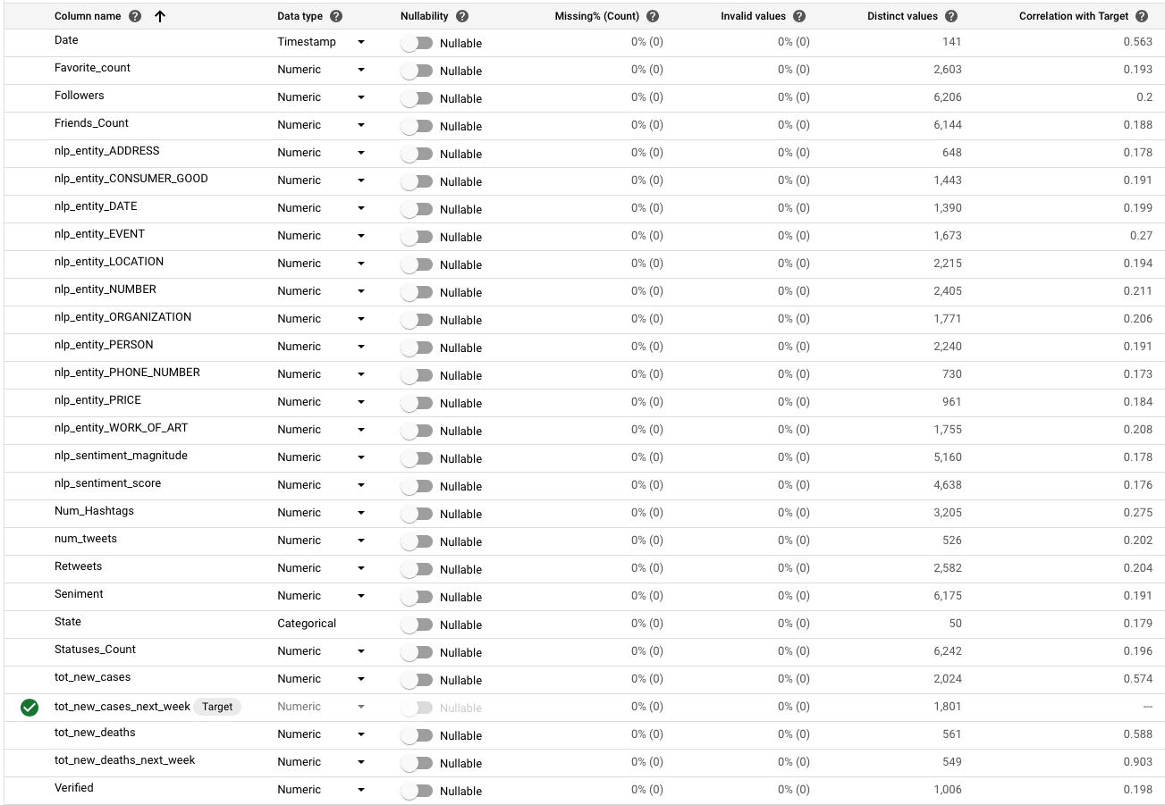
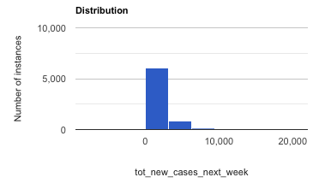
Prediction: Average number of new cases in the next week
Average = 959.757
Std = 1,910.091

Slide 11
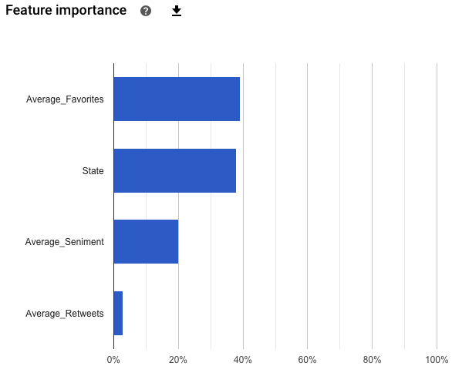
Previous Results: Only Tweet Information
Optimized for | RMSE
MAE | 450.213
RMSE | 861.151
R^2 | 0.478

Slide 12
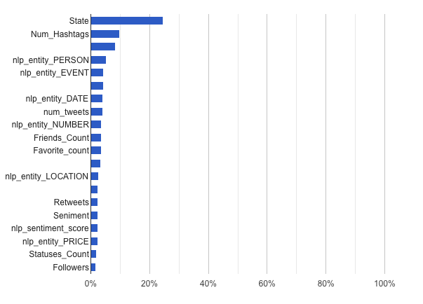
Updated Results: Predicting the Next Day
Optimized for | RMSE
MAE | 358.161
RMSE | 731.876
R^2 | 0.846

Slide 13
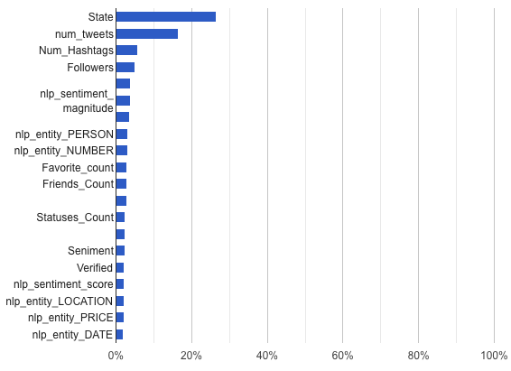
Updated Results: Predicting for the Next Week
Optimized for | RMSE
MAE | 310.734
RMSE | 650.131
R^2 | 0.881

Slide 14
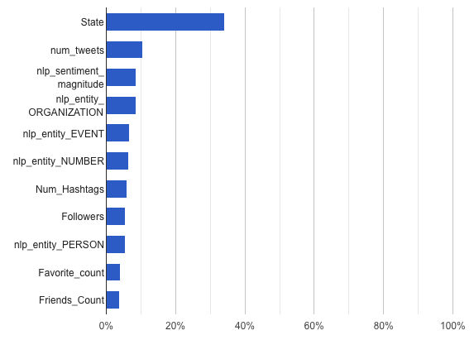
Updated Results: Using Top Features
Optimized for | RMSE
MAE | 320.108
RMSE | 710.346
R^2 | 0.855

Slide 15
Final Application
tweetcovidprediction.herokuapp.com

Slide 16
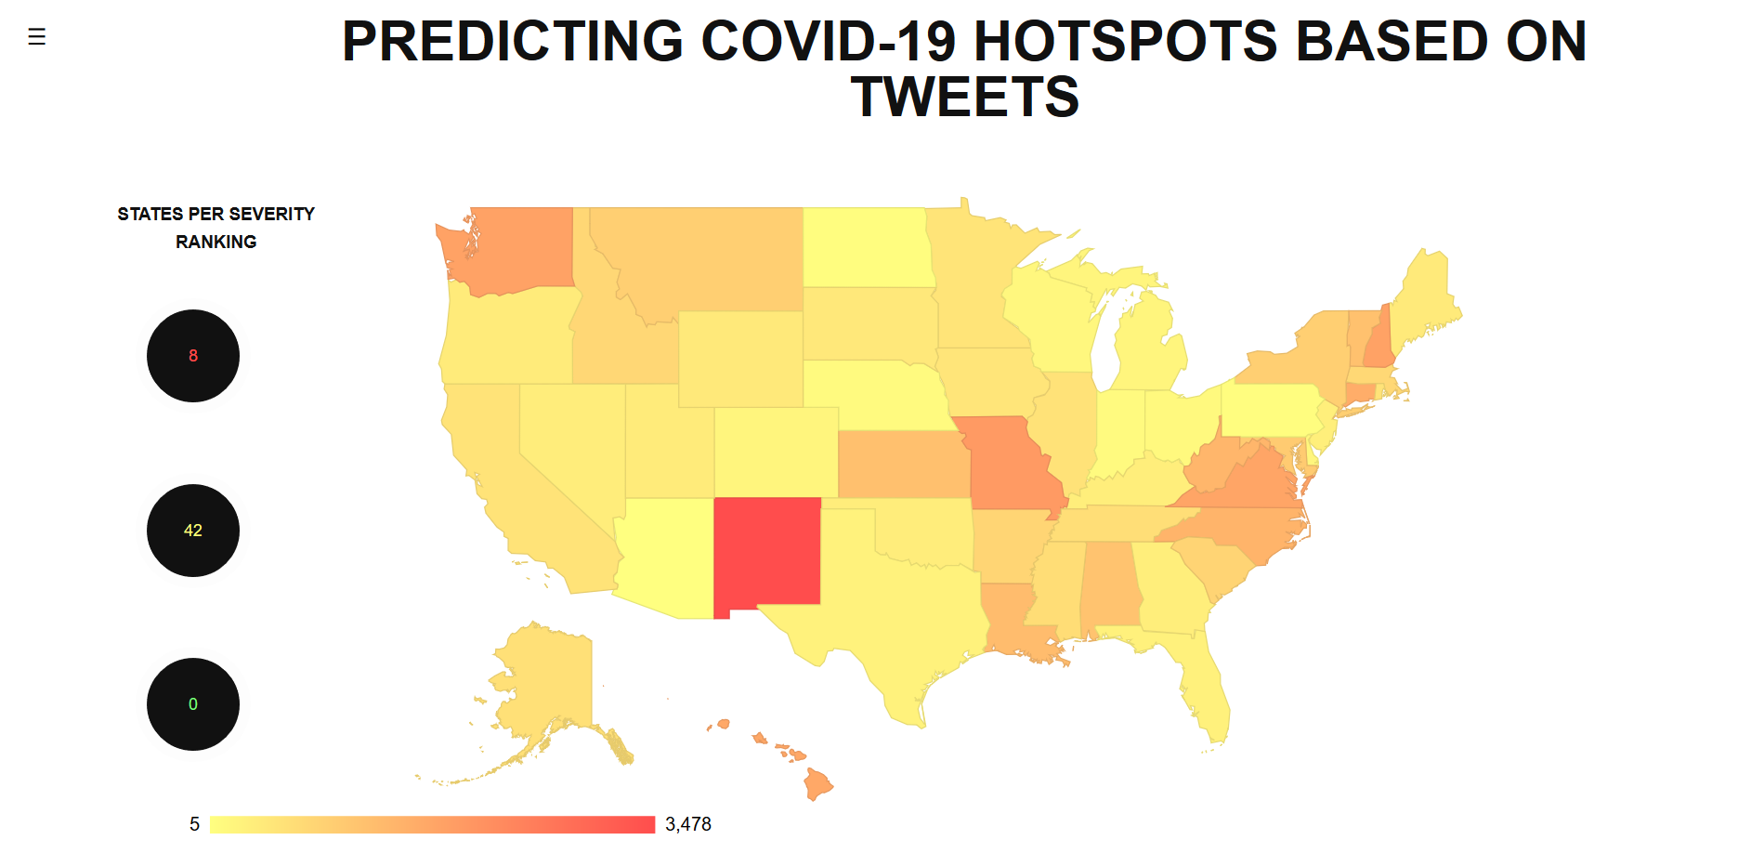

Slide 17
Final Application: Flow of Information
Tweet scraper data gets combined with Covid data, list compiled for one row per state for each day
Each line is fed into the AutoML model via rest api
AutoML model returns a prediction for each state
The predictions are passed through the flask backend running on the deployment server and displayed via the web application

Slide 18
Conclusion

Slide 19
Conclusion: Application Results
Designed an application to leverage tweet information to predict COVID-19 hotspots
Analyzed information from datasets:
Reported Covid-19 cases
Daily tweets: Information about tweets (favorites, retweets, etc.) and their content (tweet text)
NLP: Extract more information from the tweet: Sentiment scores, Entity classification
Leveraged application tools to display results
Google Cloud: AutoML rest API, Google NLP API, BigQuery, geoVis API
Heroku Deployment Servers
Flask

Slide 20
Conclusion: Lessons Taken Away
Turned into a statistical project vs AI project
Importance of analyzing data before beginning training
Learned how features play an importance in training and results
Twitter information isn’t a good indicator for COVID-19 case counts
Tried multiple methods to try to gain more relevant features from our Twitter data
There is only so much machine learning can do when given a dataset with a low correlation to the desired output
This was as experimental project and we probably wouldn’t use it as an accurate predictor for COVID-19 case counts

